Slide 1
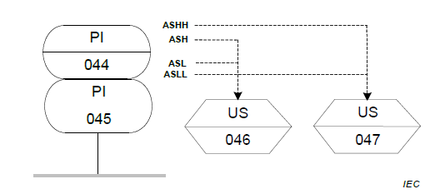
I08 Instrumentation example
Frei verwendbar

